Slide 1
Introduction
1. TiGL Workshop, September 11 / 12, Cologne
Martin Siggel
German Aerospace Center

Slide 2
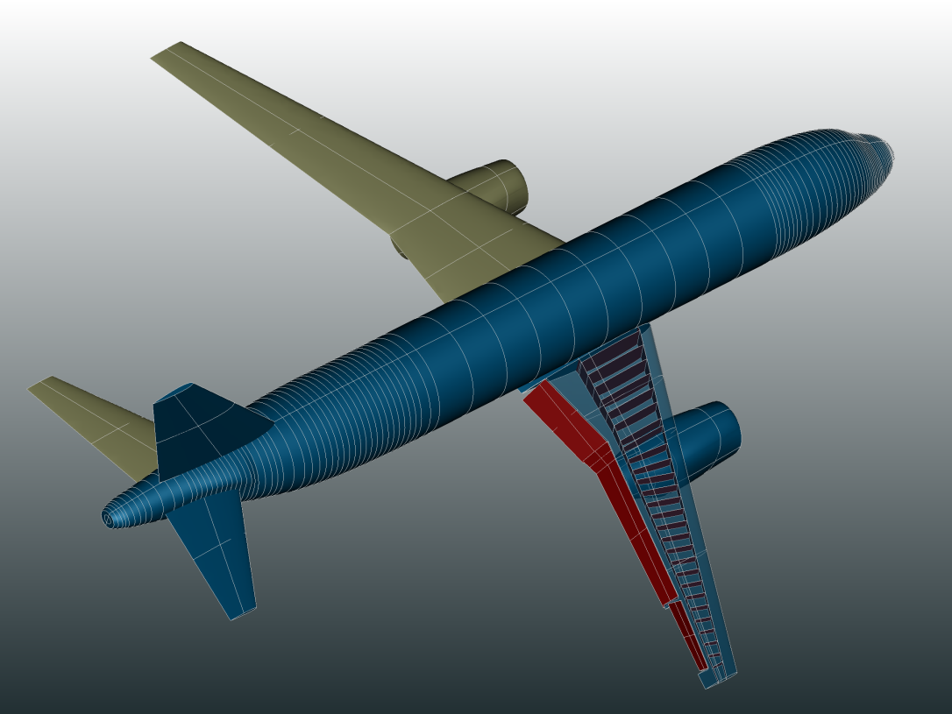
Welcome!

Slide 3
Goals of this workshop
We want to get to know you, the users
We don’t know all our users and their use cases
We want to show you our new features
There have been many new developments in TiGL, some of which you may be unaware off
There are new ways to use TiGL, giving you greater flexibility → Internal Python API
We want to identify problems
Are there any current issues that we should know about?
Are there any features that would really simplify your life with TiGL?

Slide 4
Agenda
Sept. 11.
Sept. 12.
13:00 – 13:15 | Introduction
13:15 – 13:45 | Introduction of Participants
13:45 – 14:15 | Agostino De Marco - Aircraft design tools developed at the University of Naples Federico II and their integration with DLR software
14:15 – 14:30 | Coffee Break
14:30 – 16:00 | Python API + Hands On: Basics
16:00 – 16:30 | Coffee Break
16:30 – 17:00 | Python API + Hands On: Customization and Visualization
17:00 – 18:00 | TiGL Viewer Scripting API + Hands On
19:30 | Social Event Eltzhof
09:00 – 09:30 | Sebastian Deinert - Descartes – Parametric Analysis Model Generation Using CPACS and TiGL
09:30 – 10:00 | Merlin Pelz - Curve Network Interpolation with Gordon Surfaces
10:00 – 10:15 | Coffee Break
10:15 – 11:00 | Python API + Hands On: Custom Geometry
11:00 – 12:30 | How to Contribute + Hands On
12:30 – 13:30 | Lunch
13:30 – 14:00 | Individual Q&A
14:00 | Wrap-Up

Slide 5
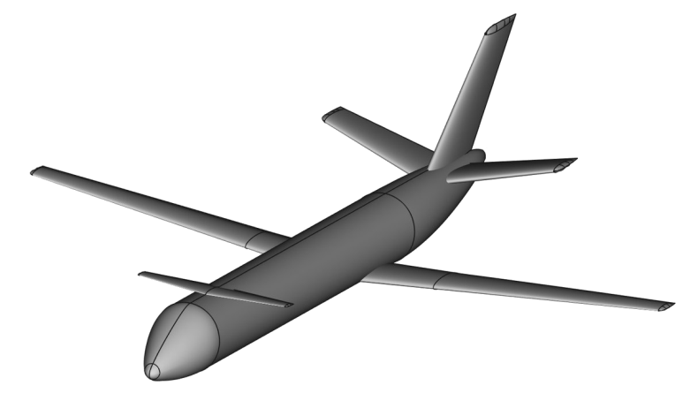
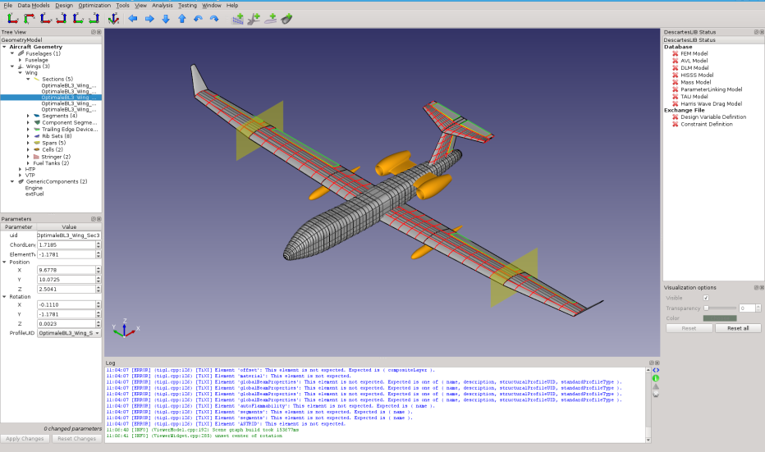
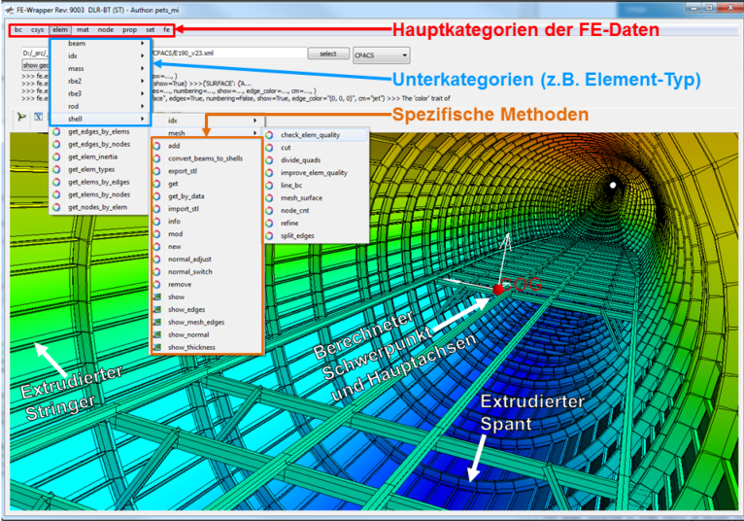
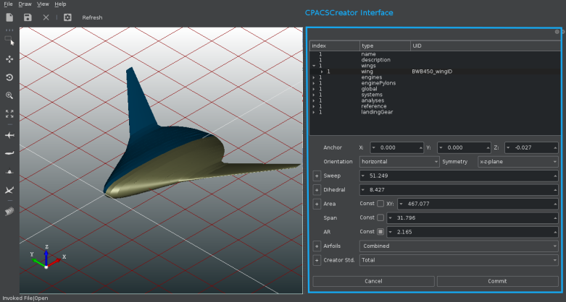
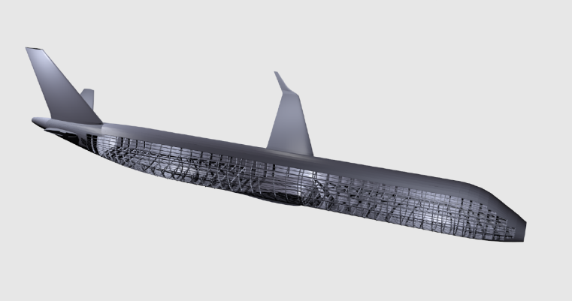
CPACS + TiGL Ecosystem is growing
JPAD,
de Marco et. al.
Descartes,
Airbus + RISC
CPACS Creator,
CFS Engineering
Pandora,
Petsch, Kohlgrüber

Slide 6
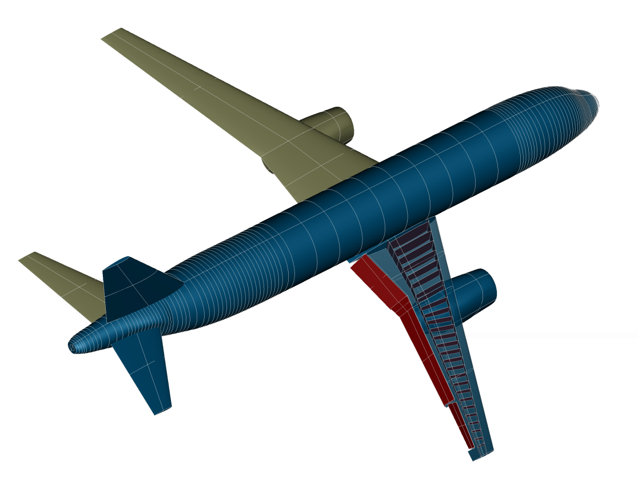
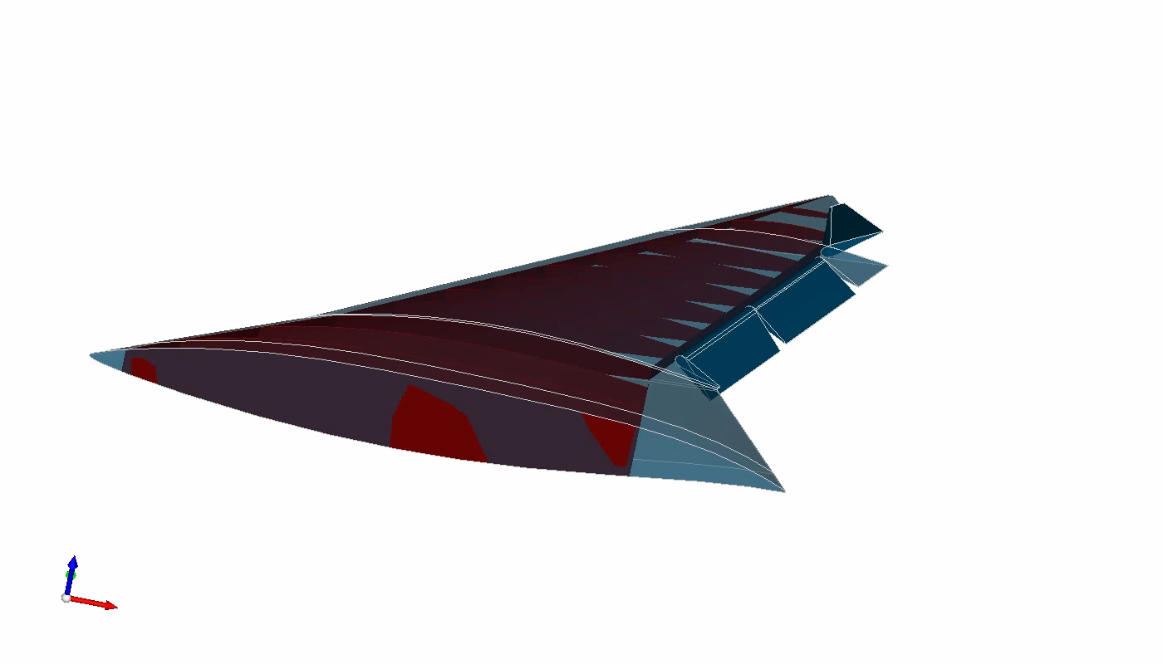
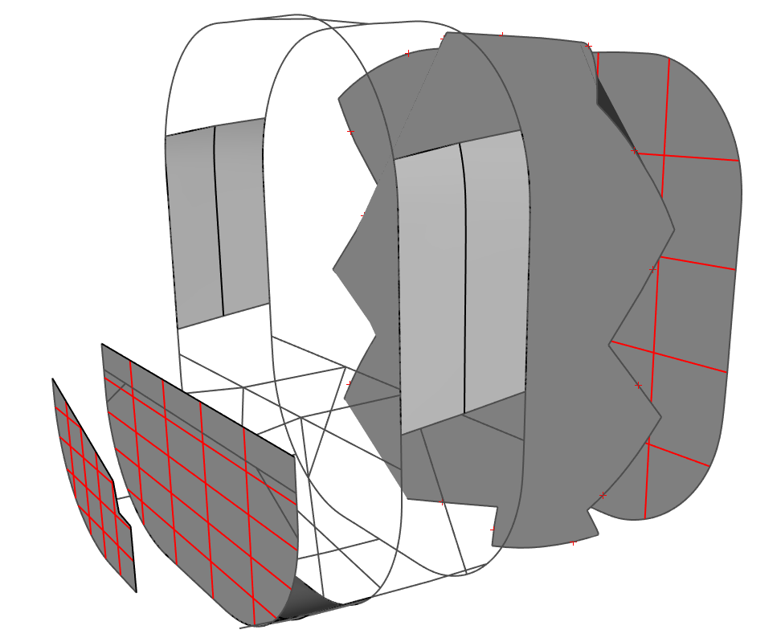


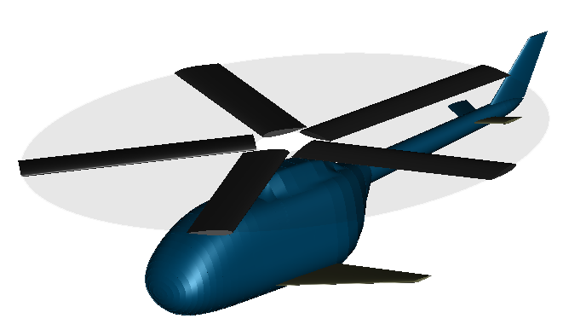
TiGL Geometry Library - Current Status
Many new geometries:
Flaps and Control Surfaces
Wing structural elements
Wing cells
Engine nacelles (WIP)
Engine pylons (WIP)
Fuselage structural elements
Rotors (e.g. for Helicopters)
Wing Cells
Large parts developed by
Automatic C++ code generation from CPACS schema
CPACS 3 support und cpacs2to3 converter tool

Slide 7
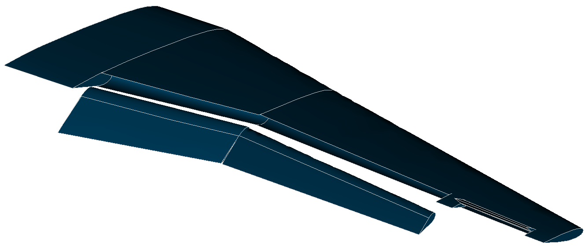

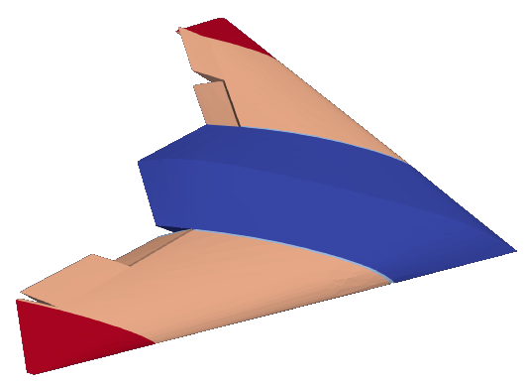
TiGL 2.2.2 + 2.2.3 Release
Implemented control surfaces devices
Trailing Edge devices
Leading Edge devices
New API functions to move flaps
TiGLViewer:
Angle of perspective can be adjusted using the scripting API with setCameraPosition and setLookAtPosition. This allows e.g. to create videos of the geometry.

Slide 8
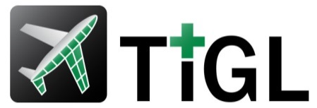
TiGL 3.0 Release Candidate
TiGL 3.0 depends on CPACS 3.0!
TiGL 3.0-RC1 Release Date: 12/17/2017
CPACS 3.0 Release Date: 31/07/2018
TiGL 3.0 Release Date: expected end 2018
Not backwards compatible to TiGL 2:
Cannot read CPACS 2 files
API changes
New Component Segment (CS) definition and associated API functions
Guide curve support for wings and fuselages for high-fidelity surface modeling according to the CPACS 3 definition.
Alternative positioning of geometries either in CS coordinates or in segment coordinates

Slide 9
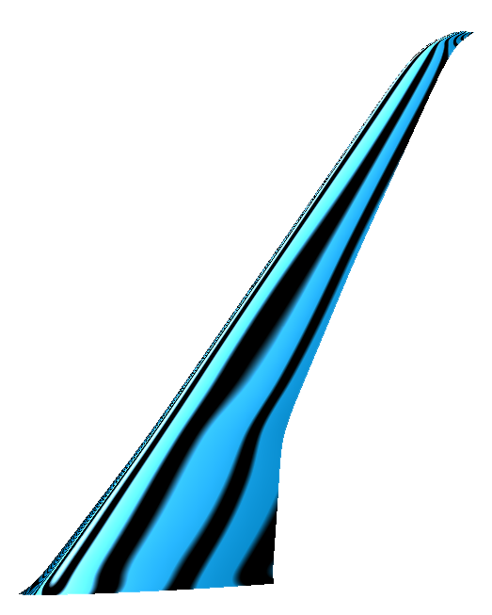
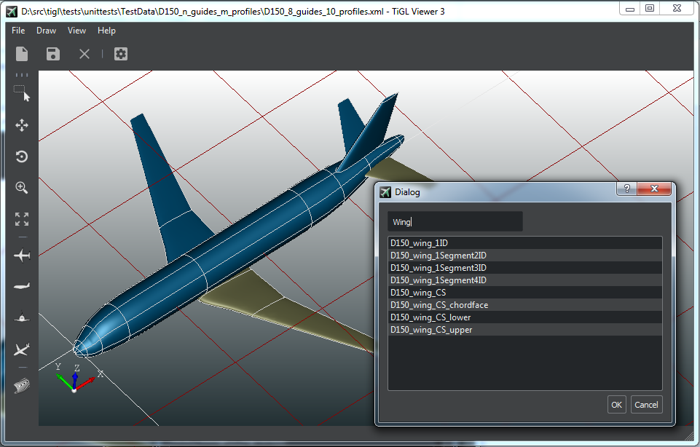
TiGL 3.0 Release Candidate
Improved speed of tiglFuselageGetPoint function.
Fully automatic code generation for CPACS reading and writing (in cooperation with Airbus D & S and RISC)
The wing structure is not yet adapted to CPACS 3 but uses the 2.3 definition. This will be updated in the next release.
Control surfaces not yet included
TiGL Viewer:
New design
Display of reflection lines to inspect surface quality.
Display of textured surfaces.

Slide 10

CPACS 2 to 3 Converter
A python script available on Github and via our conda repository
Currently the script
increments the version number to 3
adds uiDs that are now required in CPACS 3
transforms eta and xsi coordinates to new CPACS definition
converts guide curve points to the new CPACS definition
Geometry related conversions on the To-Do list:
Wing Structure
Everyone is welcome to participate!
If you need to convert something during your transition to CPACS 3.0, please
Check here if someone else has already implemented this conversion.
Else: Contribute!
Ideally, the tool is as complete as it can be.
cpacs2to3 myaircraftv2.xml -o myaircraftv3.xml

Slide 11
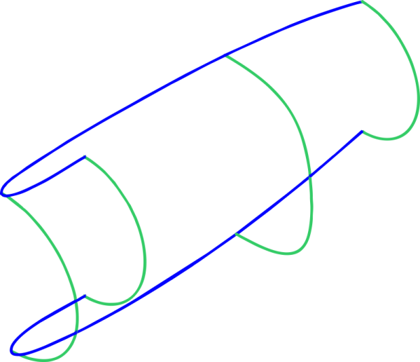
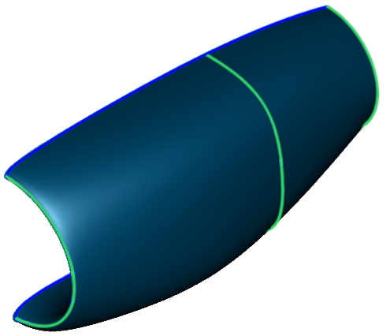
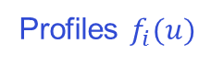
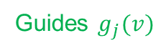
Guide Curves Support Curve network interpolation with Gordon Surfaces
Given network of profile and guide curves: Find surface that interpolates these curves
Problem: No free library available for curve network interpolation!
Custom development from OpenCASCADE for DLR based on Coons-patches showed poor results
An algorithm based on Gordon Surfaces is much more promising (→Merlin Pelz)
Profiles $f_{i}(u)$
Guides $g_{j}(v)$

Slide 12
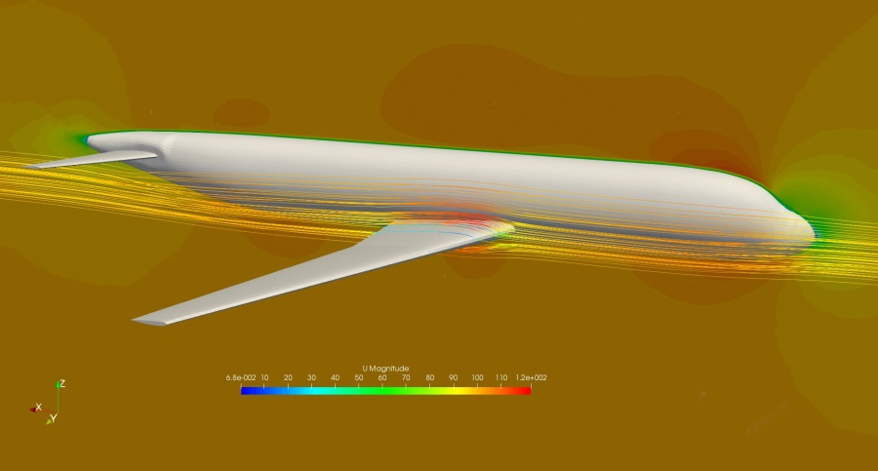
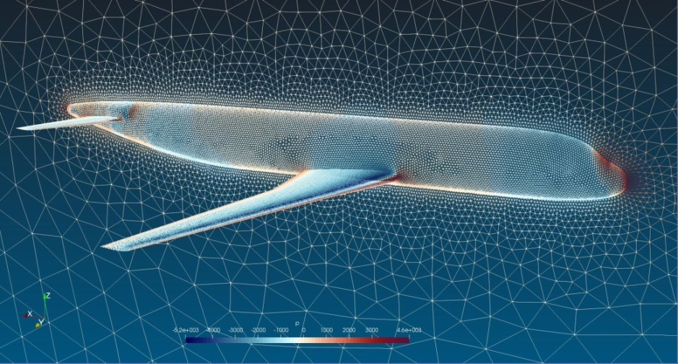
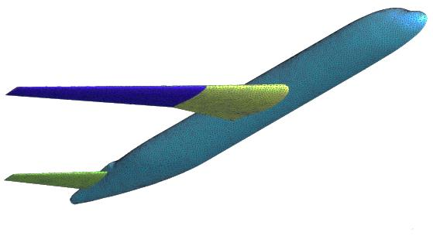
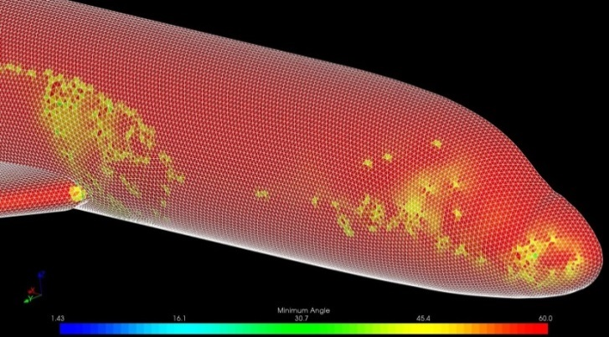
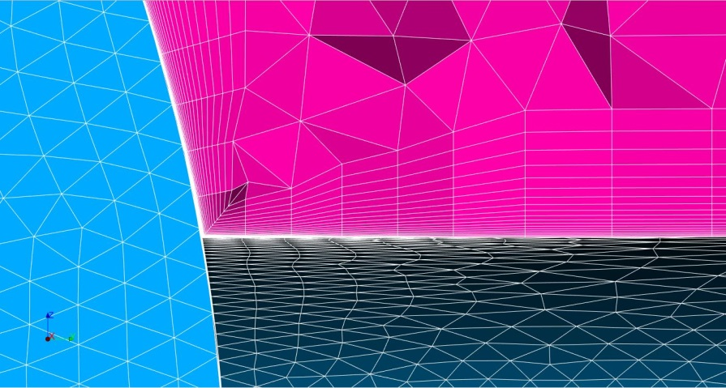
Mesh Creation with TiGL
Current student project (Paul Putin)
Investigate the possibility of implementing mesh-export functionality
Goal: Robustly generate a mesh with few options
for radar-control analysis
for low- to mid-fidelity CFD simulations (e.g. in TAU, OpenFOAM …)
as an initial mesh for a commercial meshing tool
Write wrapper for OpenSource Mesher (Smesh+NetGen, GMsh, …)

Slide 13
Roadmap
TIGL 3.0
TiGL 3.1
Future
CPACS 3 compatible wing structure
Replace Coons patch algorithm with Gordon surfaces
Re-introduce control surfaces from TiGL 2
Modelling of Nacelles + Pylon
Helper geometries for Mesh generators
Own meshes for mid-fi simulations
Variable geometries
Modelling of intakes and channels

Slide 14
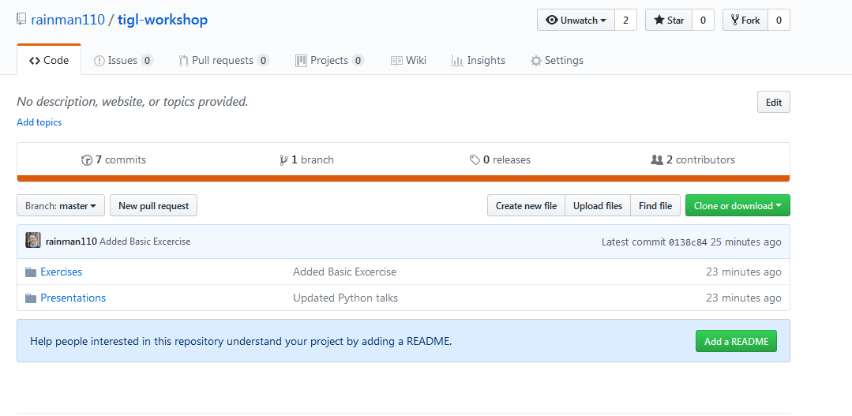
Course Material Online
Download / git-clone the TiGL workshop material from
https://github.com/rainman110/tigl-workshop

Slide 15
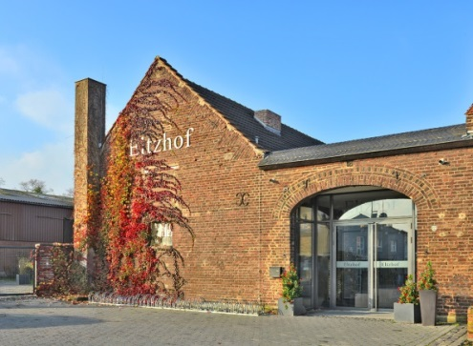
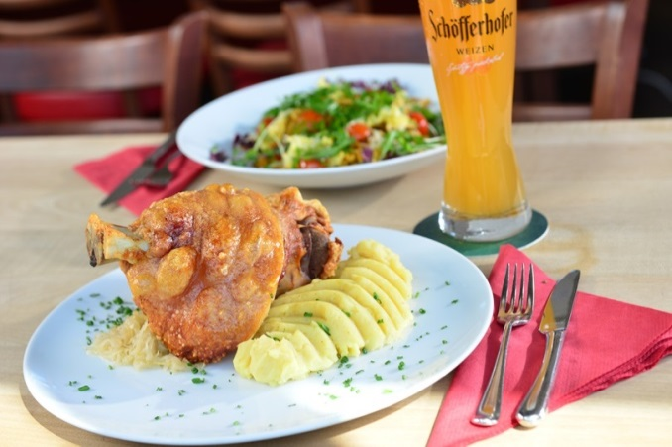
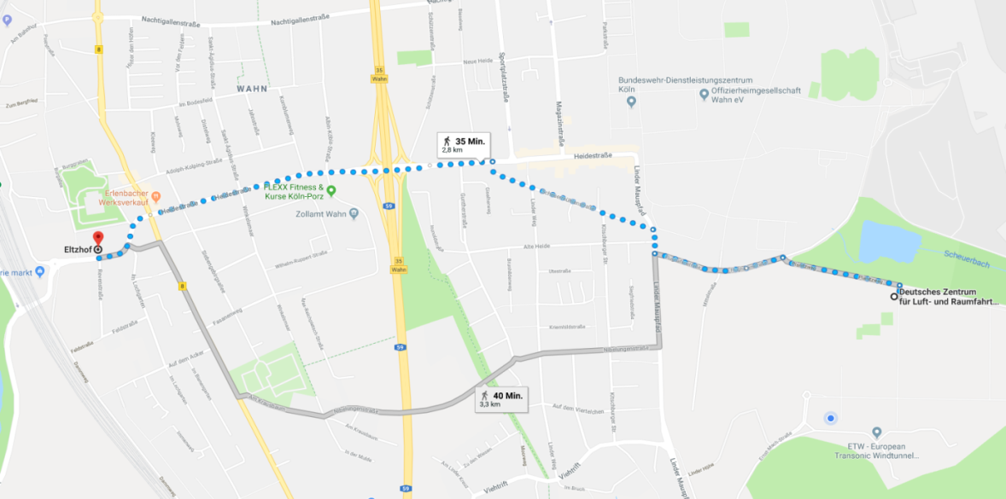
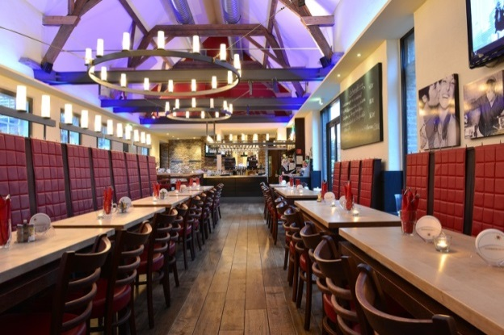
Social event today
Dinner at Restaurant Eltzhof, Köln-Wahn:
With Bus 162 from DLR or Bus 160 from Scheuermühlenstr to Wahn Kirche. Then about 300m walking to the Eltzhof restaurant.

Slide 16
Introduction of the participants
Who are you?
What are you working on?
How is your work related to TiGL or CPACS?
What are your expectations of the next 2 days?

